Slide 1
STUDENT HIVE
CS 691 – Computer Science Capstone Project

Slide 2
AGENDA

Slide 3
AGENDA
Review progress towards project deadlines and milestones and discuss any delays or challenges encountered and identify solutions.
Ensure alignment on the development progress and tasks completed and address any roadblocks hindering development and strategize solutions.
Mark important submission dates and deadlines for the project deliverables on the shared excel sheet with everyone's schedules.
Review presentation topics to ensure they align with project goals and discuss iterative updates to the presentation and delegate tasks accordingly.
Brainstorm and study through personas to understand client requirements thoroughly and Identify and prioritize the necessary features and functionalities from the client's perspective.
Discuss potential risks associated with the project and their impact and Strategize mitigation plans to address identified risks effectively.
Emphasize the importance of interaction, attendance, cooperation, teamwork and discuss the significance of individual contributions and attention to detail for project success.
Sync on the next steps for development, including task assignments, deadlines and Outline action items and responsibilities for each team member.
Recap key discussion points and action items also confirm the date and time for the next meeting, if necessary and ensure open communication and collaboration among team members.

Slide 4
Team Members & Roles

Slide 5

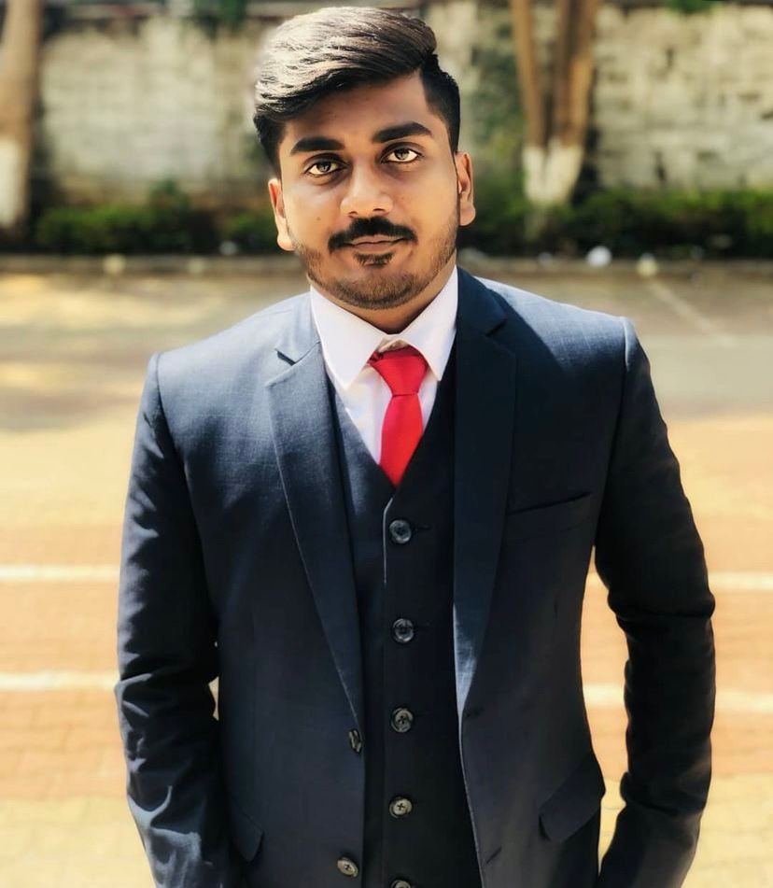


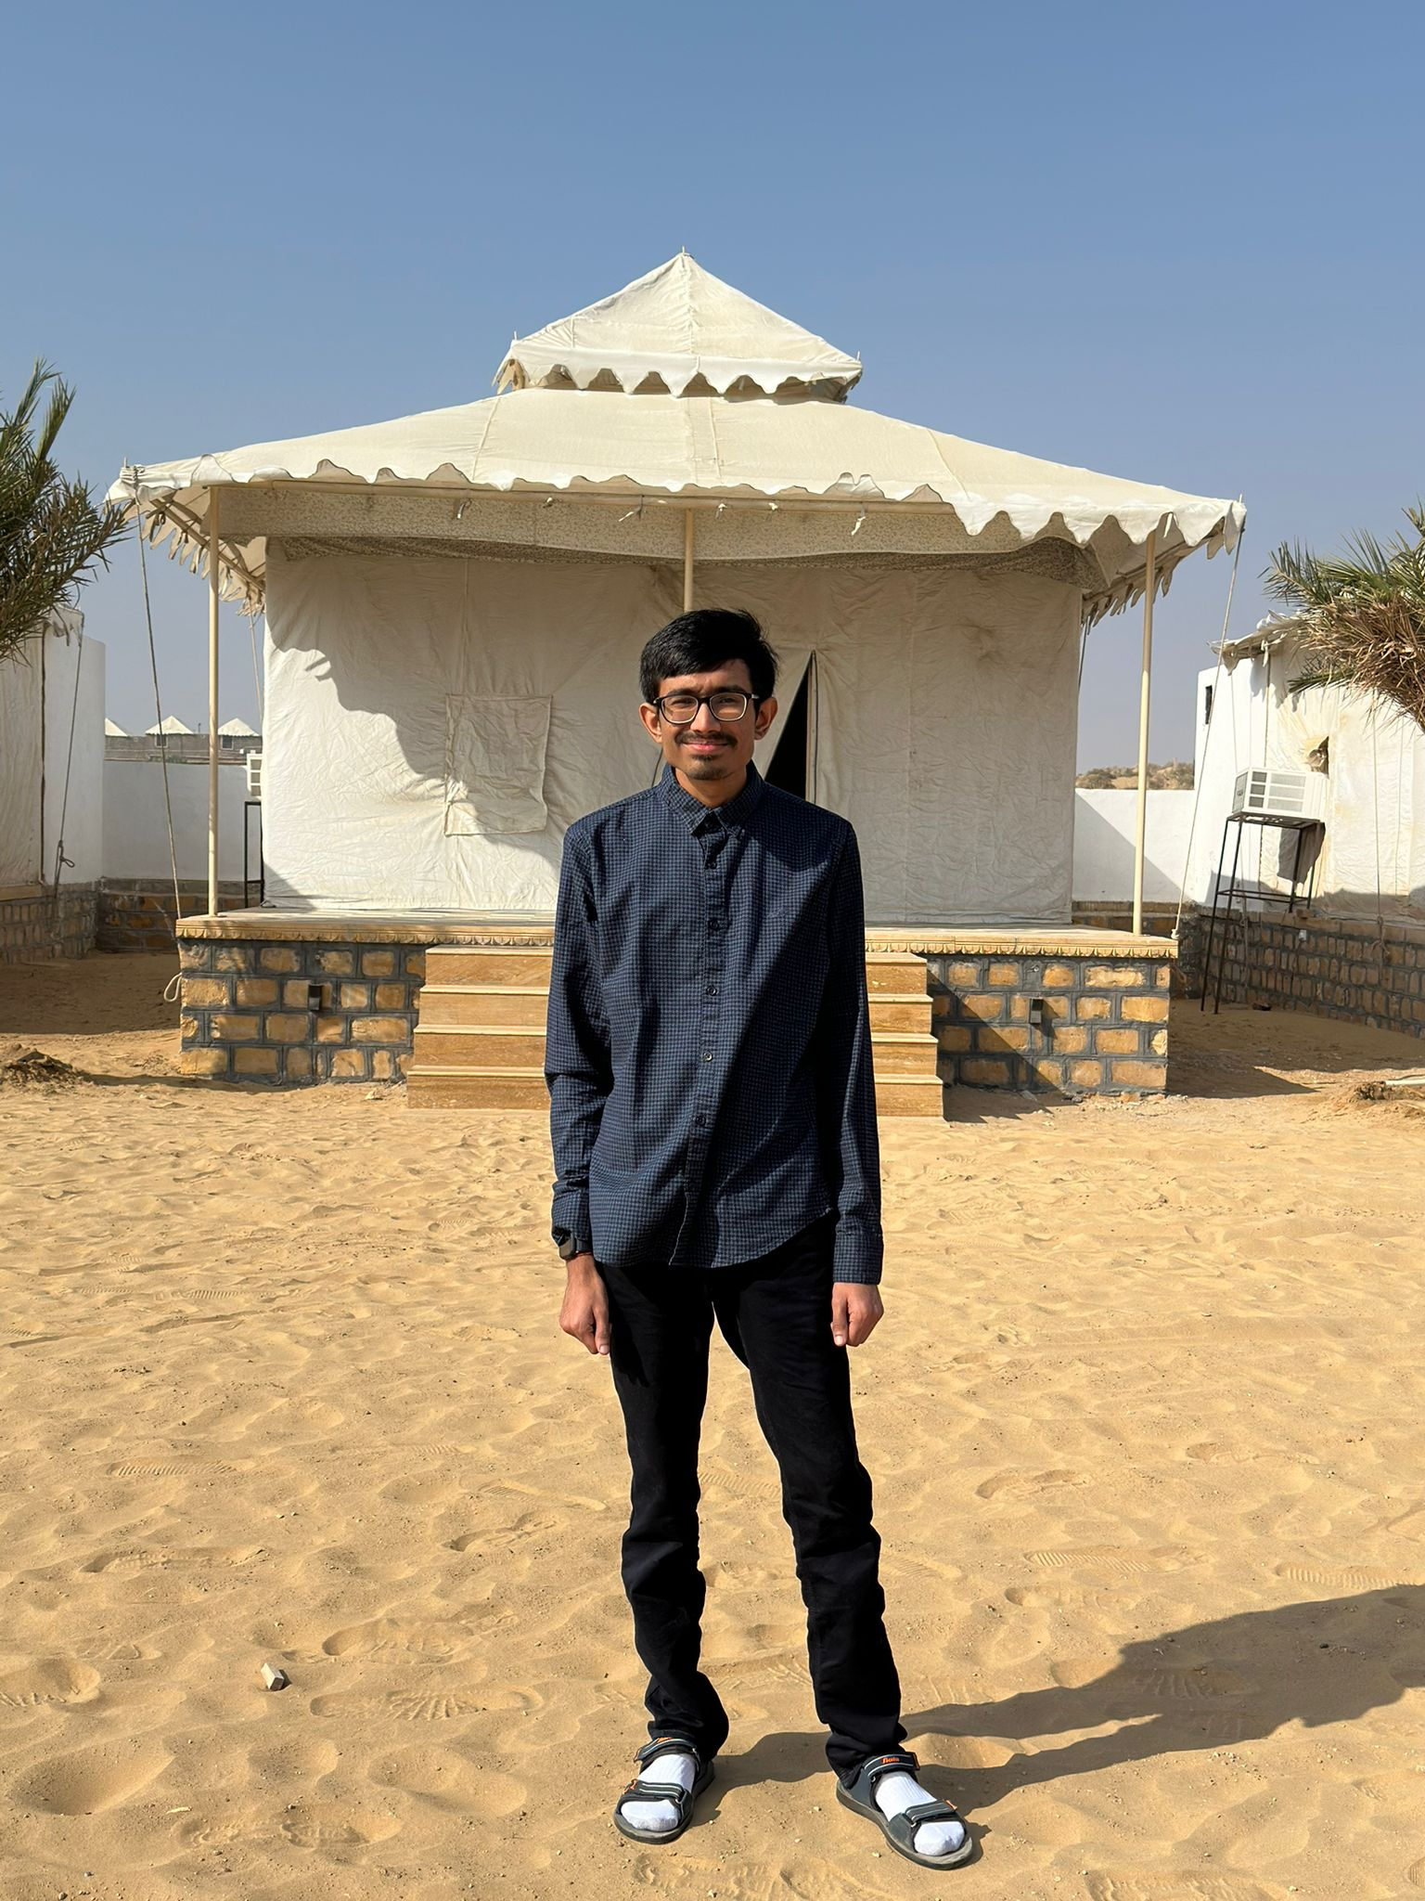
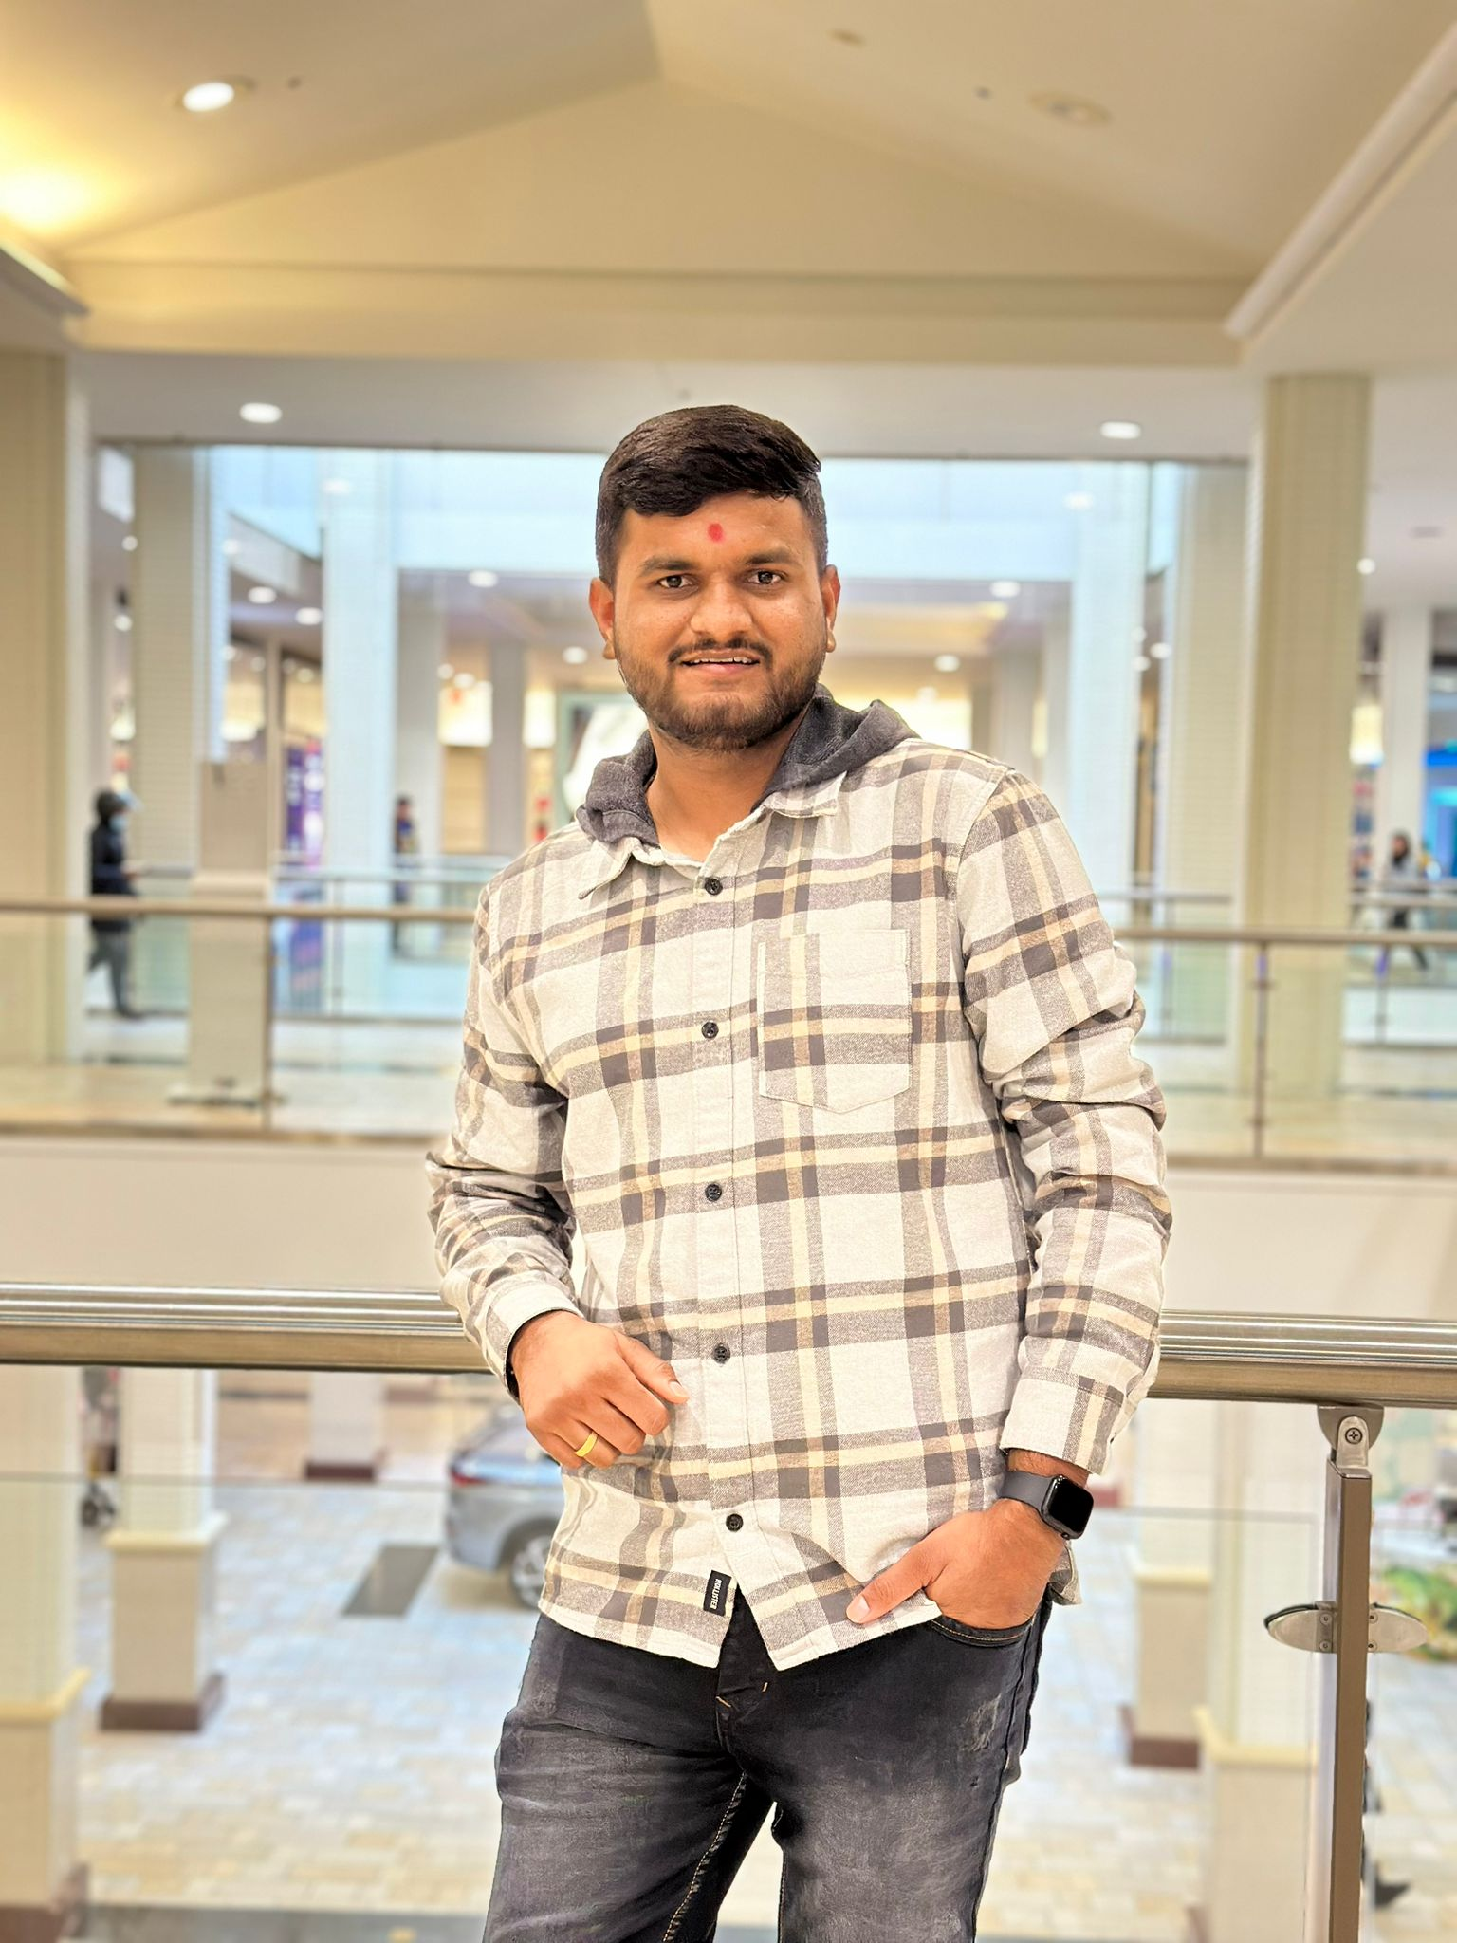
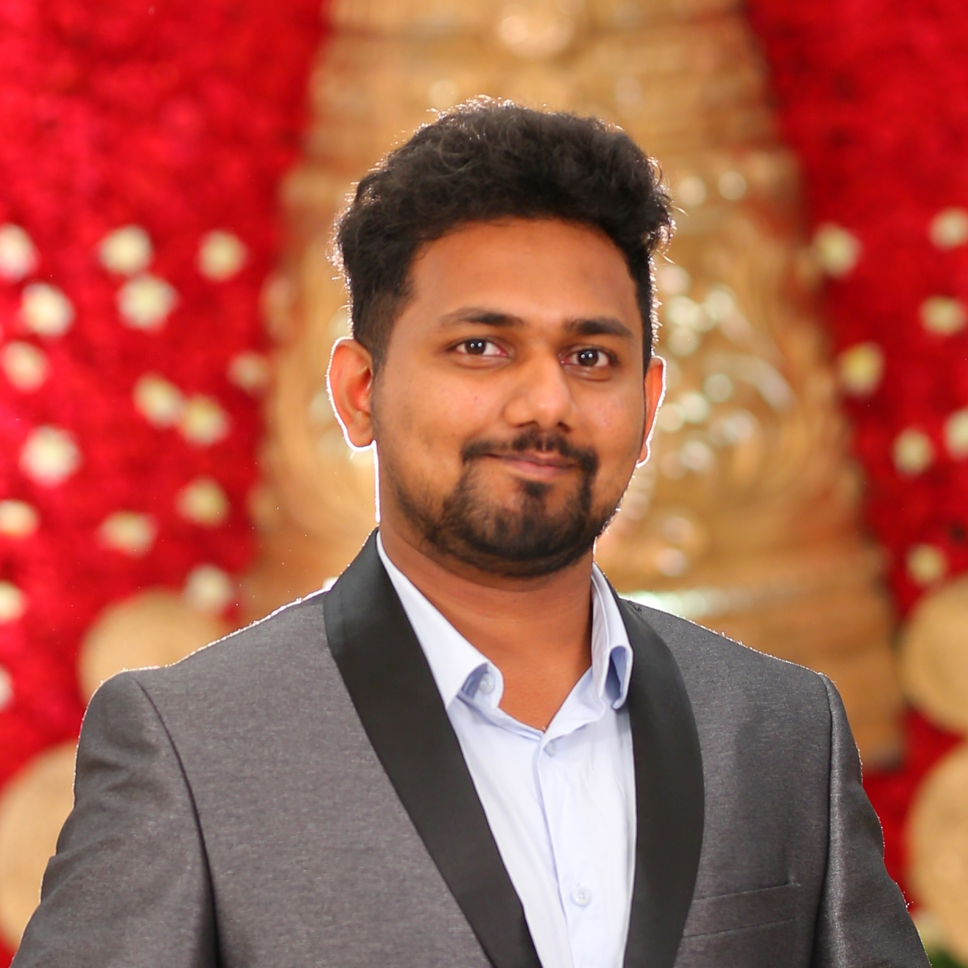
MEET OUR TEAM
SMIT
SUJAN SIDDARTH
KIRAN KUMAR
YASHKUMAR
FRONT END DEVELOPER
TESTER
FULL STACK DEVELOPER
DATABASE ADMINSTRATOR
PARTH
SIDDHARTHKUMAR
RAJ KOUSHIK
PROJECT MANAGER
DATA ANALYST
FULL STACK DEVELOPER

Slide 6
IMPROVEMENTS

Slide 7
PROFESSOR FEEDBACK
In the slide titled 'Improvements Made from Professor Feedback', add bullet points detailing the feedback received and the implemented improvements.
In the 'Architecture Diagram' slide, specify which Architecture Diagram is being presented.
Ensure that the 'Algorithms', 'Completed/Committed Ratio', and 'Team's Historical Velocity (Average)' slides are included in the presentation as per the checklist.
Ensure that you are utilizing the user stories syntax by including 'so that' after the functionality. For example, 'As a [user], I want [functionality], so that [benefit from it]'.
Ensure that your test cases include User Story IDs to link them with the corresponding stories, indicating which stories the tests belong to.
Note that user stories in Jira are created using 'Issue Type,' and tasks are created using the 'Task' type.
Ensure that the 'Team Velocity Chart', 'Sprint Burndown Chart', 'Completed/Committed Ratio', and 'Team's Historical Velocity (Average)' slides are included in the presentation as per the checklist.
Make sure to work on the Retrospective and ensure that all team members are present during the Retrospective meeting.
Ensure that you follow the order from the slide checklist present in your checklist workbook.

Slide 8
IMPROVEMENTS made from professor feedback
Specified the Architecture Diagram being presented (e.g. System Architecture, Deployment Architecture, etc.)
Included slides for 'Algorithms', 'Completed/Committed Ratio', and 'Team's Historical Velocity (Average)' as per the checklist
Utilized the user stories syntax by including 'so that' after the functionality (e.g. 'As a [user], I want [functionality], so that [benefit]')
Linked test cases with corresponding User Story IDs to indicate which stories the tests belong to
Included 'Team Velocity Chart', 'Sprint Burndown Chart', 'Completed/Committed Ratio', and 'Team's Historical Velocity (Average)' slides as per the checklist
Ensured all team members were present during the Retrospective meeting
Followed the order from the slide checklist present in the checklist workbook

Slide 9
PROBLEM STATEMENT

Slide 10
PROBLEM STATEMENT
In the current landscape of student housing, there exists a lack of secure and convenient platforms tailored specifically to the needs of students seeking shared living arrangements. Many students struggle to find reliable and trustworthy accommodation options that align with their preferences, leading to frustration and uncertainty in their housing search. Additionally, the absence of comprehensive resources such as transportation information and nearby amenities further complicates the process, leaving students feeling overwhelmed and disconnected from their potential living environments. As a result, there is a pressing need for a solution that addresses these challenges and provides students with a seamless and empowering experience in finding suitable accommodation.

Slide 11
PROJECT DESCRIPTION

Slide 12
PROJECT DESCRIPTION
"Student Hive" is a secure and convenient platform designed for students seeking shared living arrangements. By registering with their school email, users gain access to comprehensive listings tailored to their accommodation preferences and budgeting needs. Advanced search options and communication tools facilitate connections with potential roommates or landlords, while additional resources such as transportation information and nearby amenities enhance the overall living experience. With support and community engagement features available, "Student Hive" empowers students to confidently navigate their search and find the perfect accommodation suited to their needs.

Slide 13
PERSONAS

Slide 14

Persona 1: Emily, Budget-Conscious Student
Name: Emily
Age: 25
Location: Pacific Northwest, USA
Salary: $20,000 per year
Job: Graduate Student Research Assistant
Family: Single, no children
Profile: Emily is a dedicated graduate student who balances her studies with a part-time job, all while living a sustainable lifestyle.
Interests: Environmental science, outdoor activities, sustainable living practices.
Frustrations: Difficulty in finding affordable, eco-friendly housing near campus and compatible roommates.
Goals: To live in an affordable, sustainable home close to campus with roommates who share her eco-conscious values.

Slide 15

Persona 2: Alex, Intern/Co-op Seeker
Name: Alex
Age: 22
Location: NY , USA
Salary: $8,000 (Summer Internship Stipend)
Job: Undergraduate Computer Science Student/Intern
Family: Single, no children
Profile: Alex is a focused computer science student and intern, seeking convenient housing to support her summer internship and interests.
Interests: Coding, gaming, tech meetups.
Frustrations: Challenges in finding short-term, furnished, affordable housing close to her internship.
Goals: To find flexible housing that enables her to concentrate on his internship and personal tech projects.

Slide 16
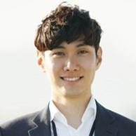
Persona 3: Jordan, Graduate Student/Young Professional
Name: Jordan
Age: 27
Location: Austin, Texas, or similar vibrant city
Salary: $50,000 per year
Job: Marketing Professional/Graduate Student
Family: Single, no children
Profile: Jordan is an ambitious marketing professional and potential graduate student, seeking a lifestyle balance in an urban environment.
Interests: Photography, social media, urban exploration, cafes, co-working spaces.
Frustrations: Finding an affordable place in a desirable neighborhood that caters to her professional and social needs.
Goals: To secure a living situation that aligns with her aspirations for career growth and an active social life in a dynamic neighborhood.

Slide 17
MINIMAL VIABLE PRODUCT STUDENTHIVE

Slide 18
MINIMAL VIABLE PRODUCT (mvp)
The following are the features that we are covering in our MVP:
Landing Page
Login page with Sign In, Sign up and Forgot Password
Home Page with Map and Listings

Slide 19
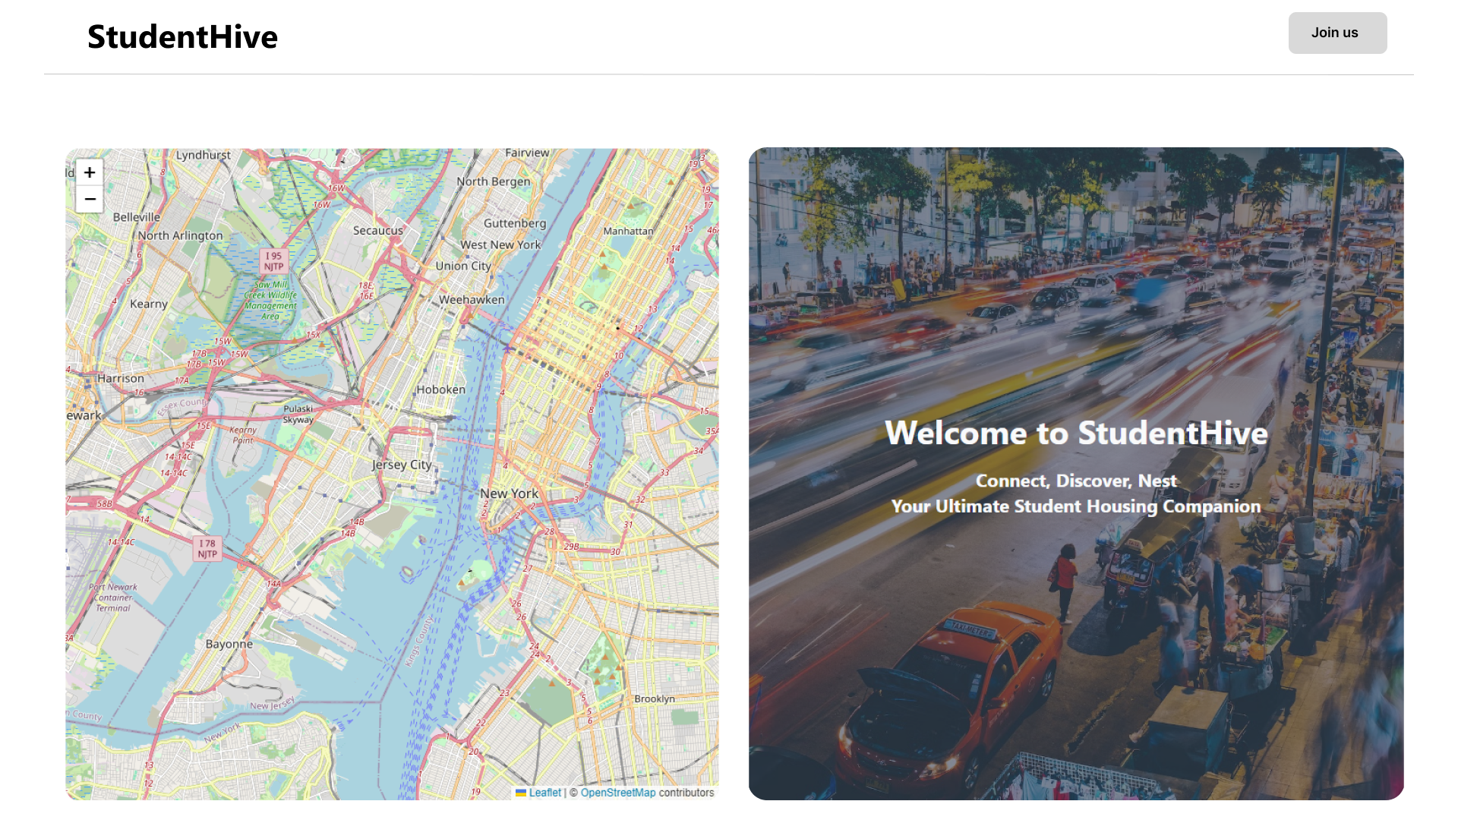
Landing page (FIGMA PROTOTYPES)

Slide 20
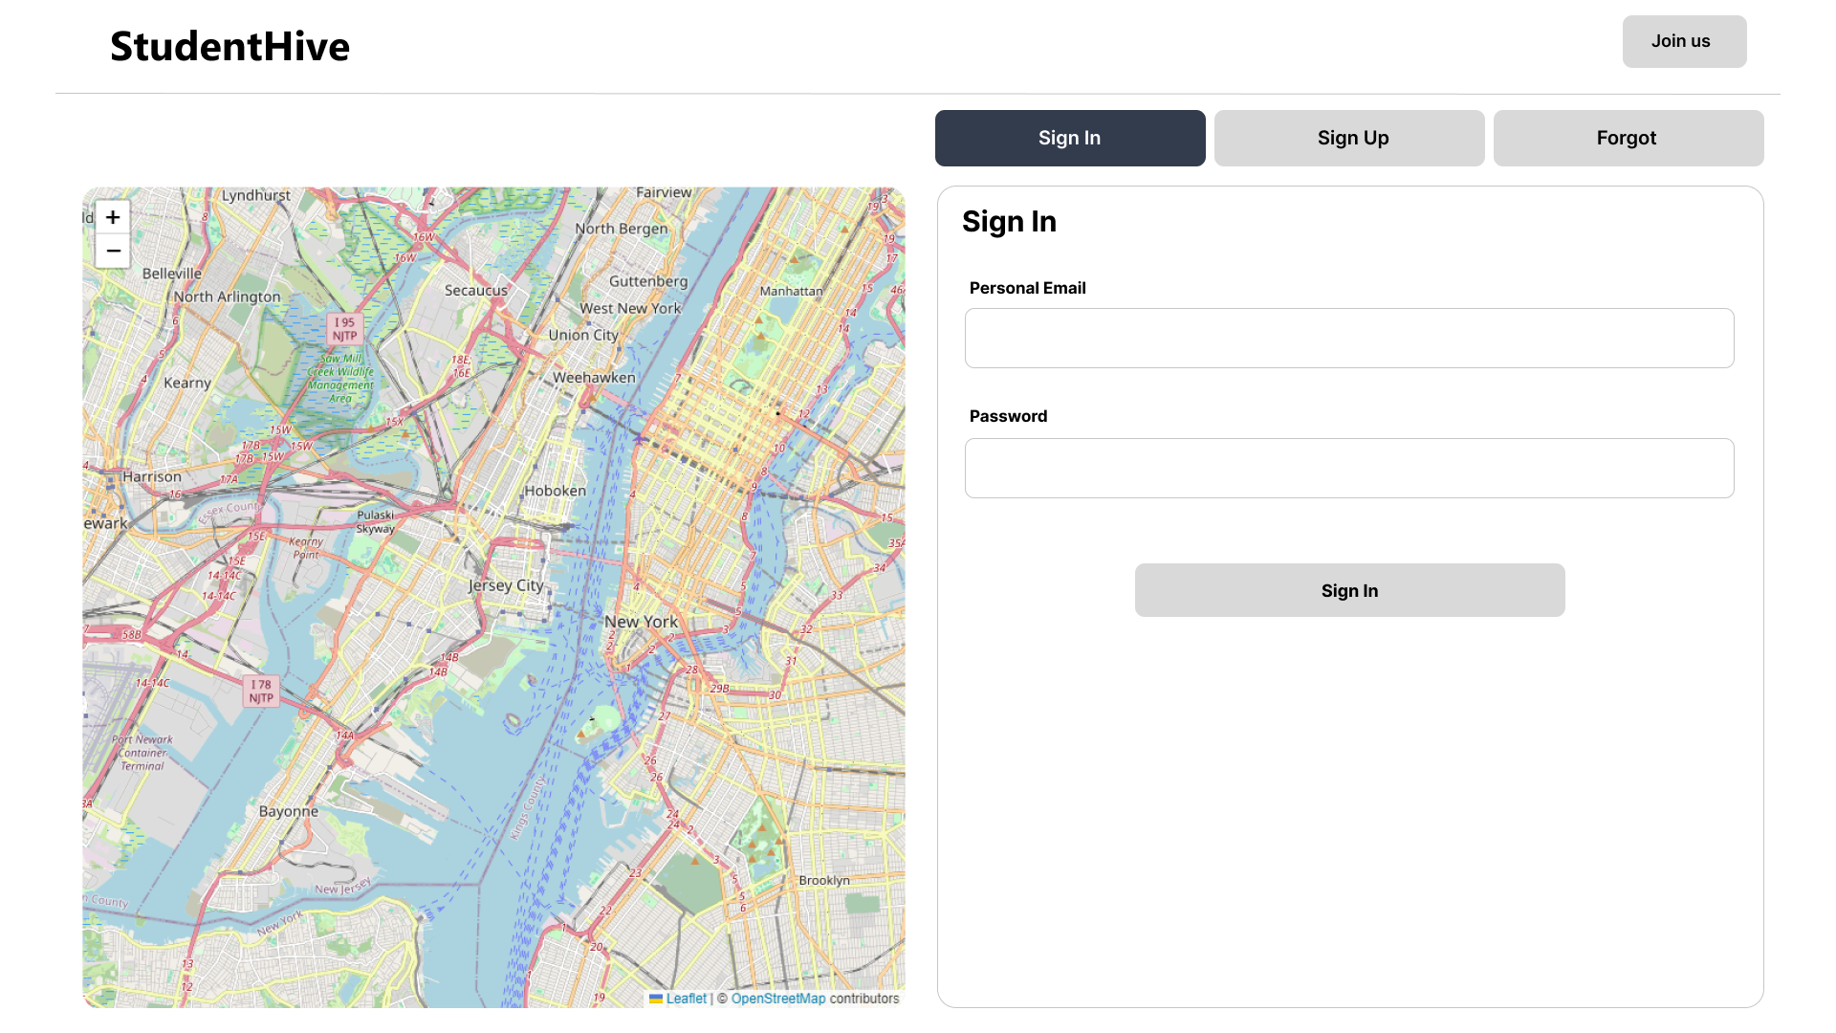
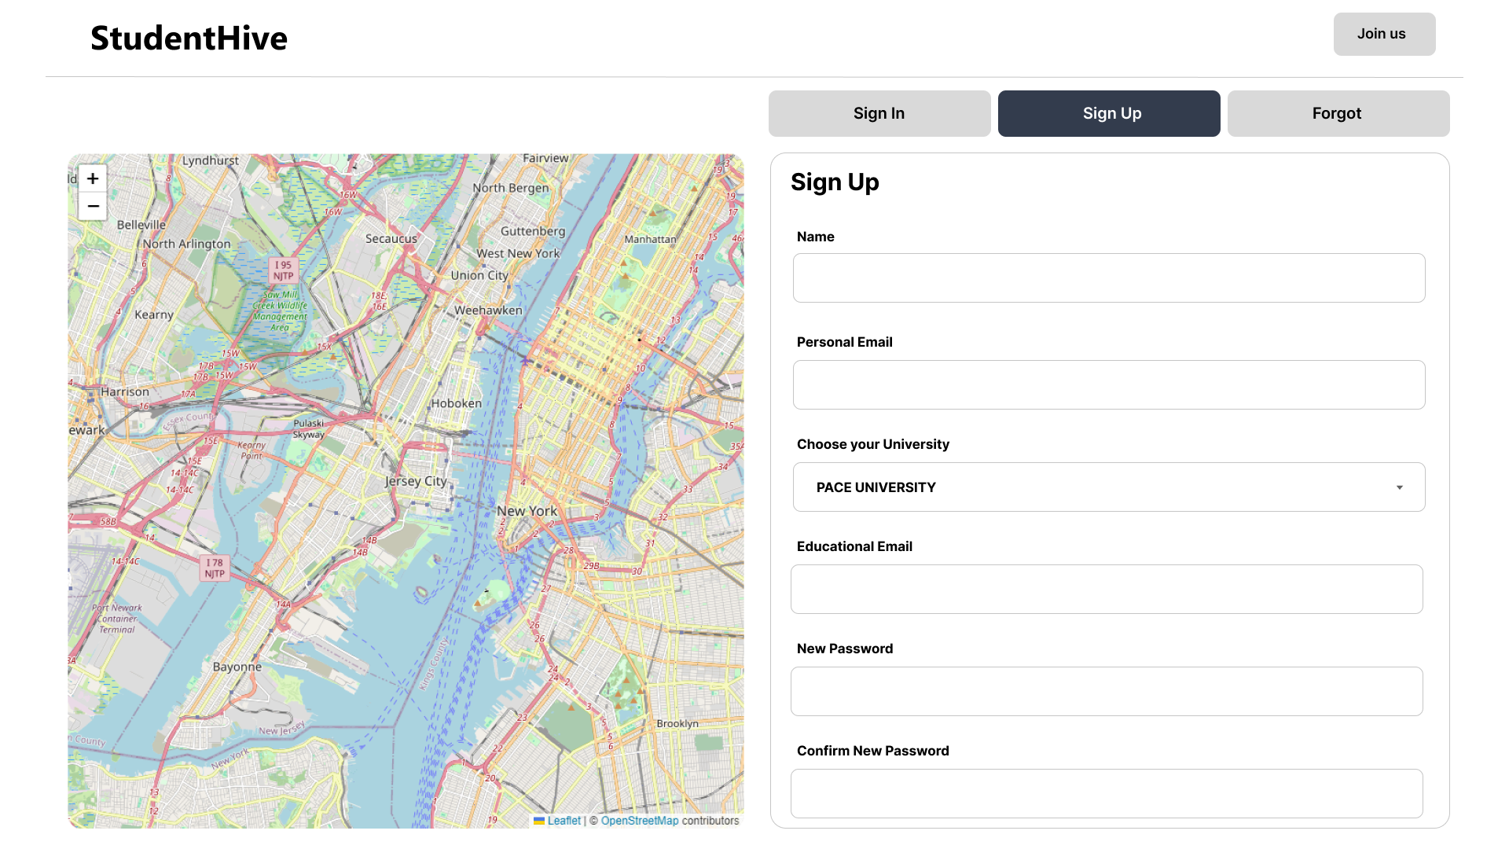
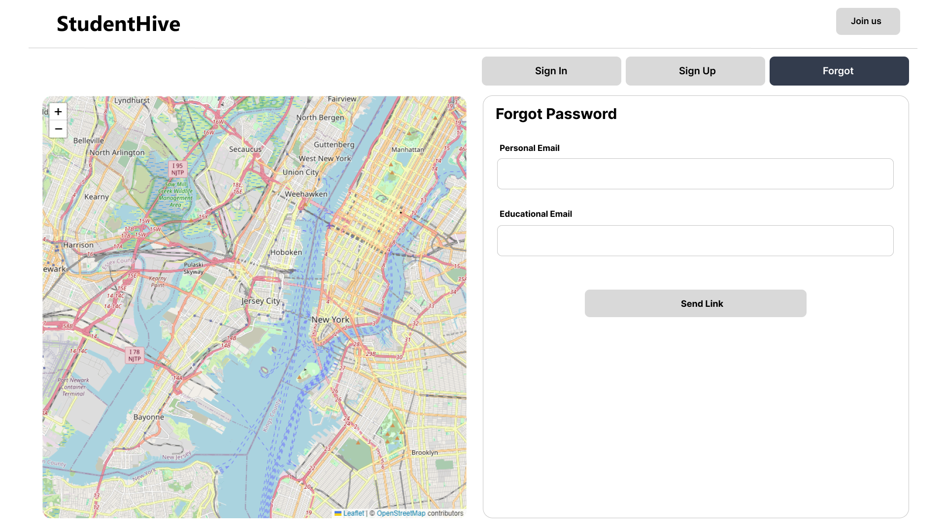
Login page( Sign in, sign up, forgot) (FIGMA PROTOTYPES)

Slide 21
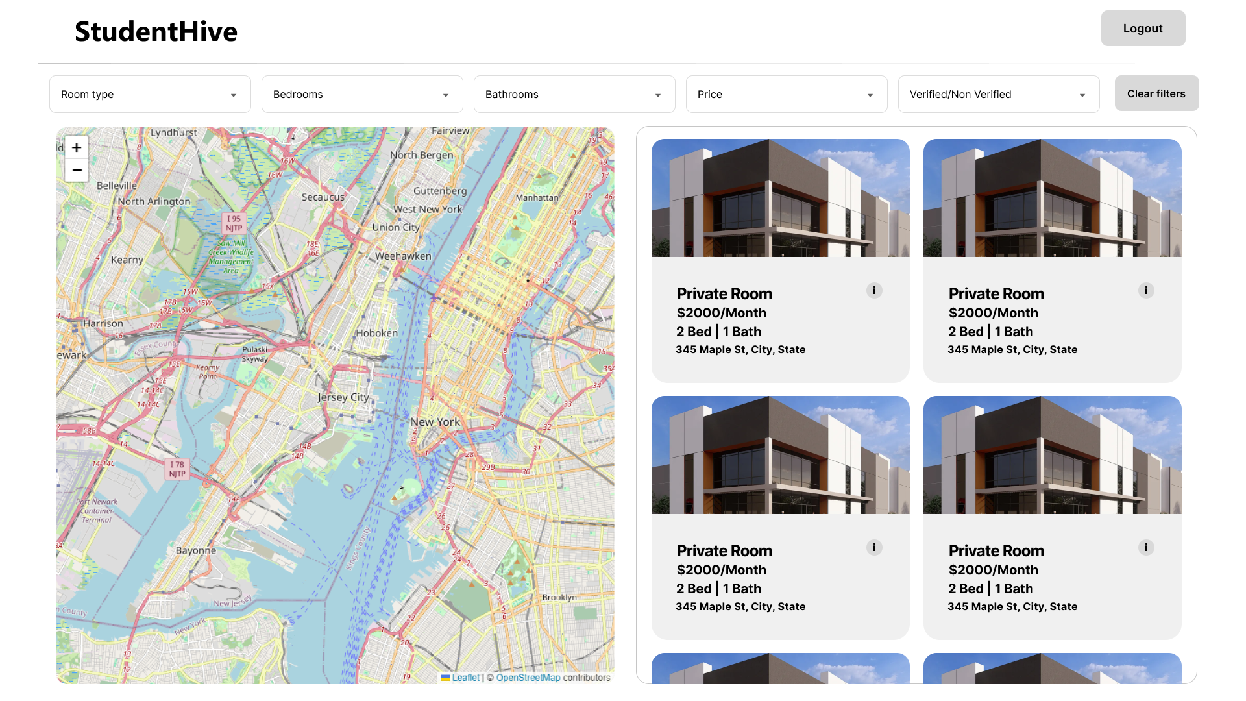
Home Page (FIGMA PROTOTYPES)

Slide 22
Technologies & Algorithms

Slide 23
TECHNOLOGIES
Front End
React, Oauth2.0, TanStack Query(Context API - State Management), Axios, Zod (Validation)
Back End
Node JS, Fastify, MongoDB, Passport JS(Auth), Mongoose (ORM)
ALGORITHMS
KNN, Linear Regression

Slide 24
DIAGRAMS

Slide 25
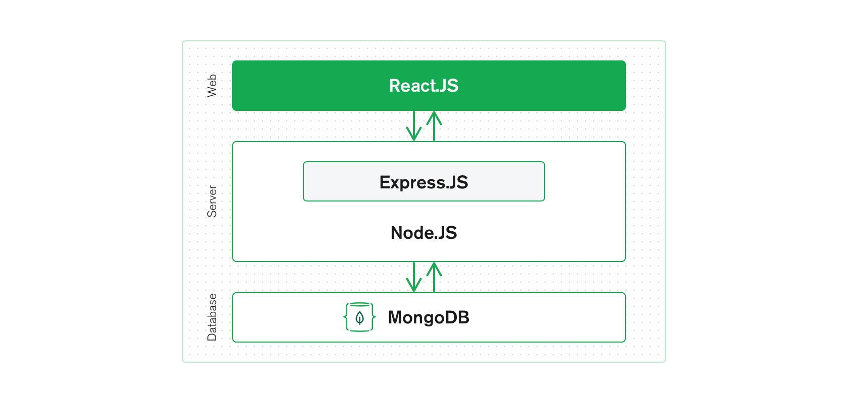
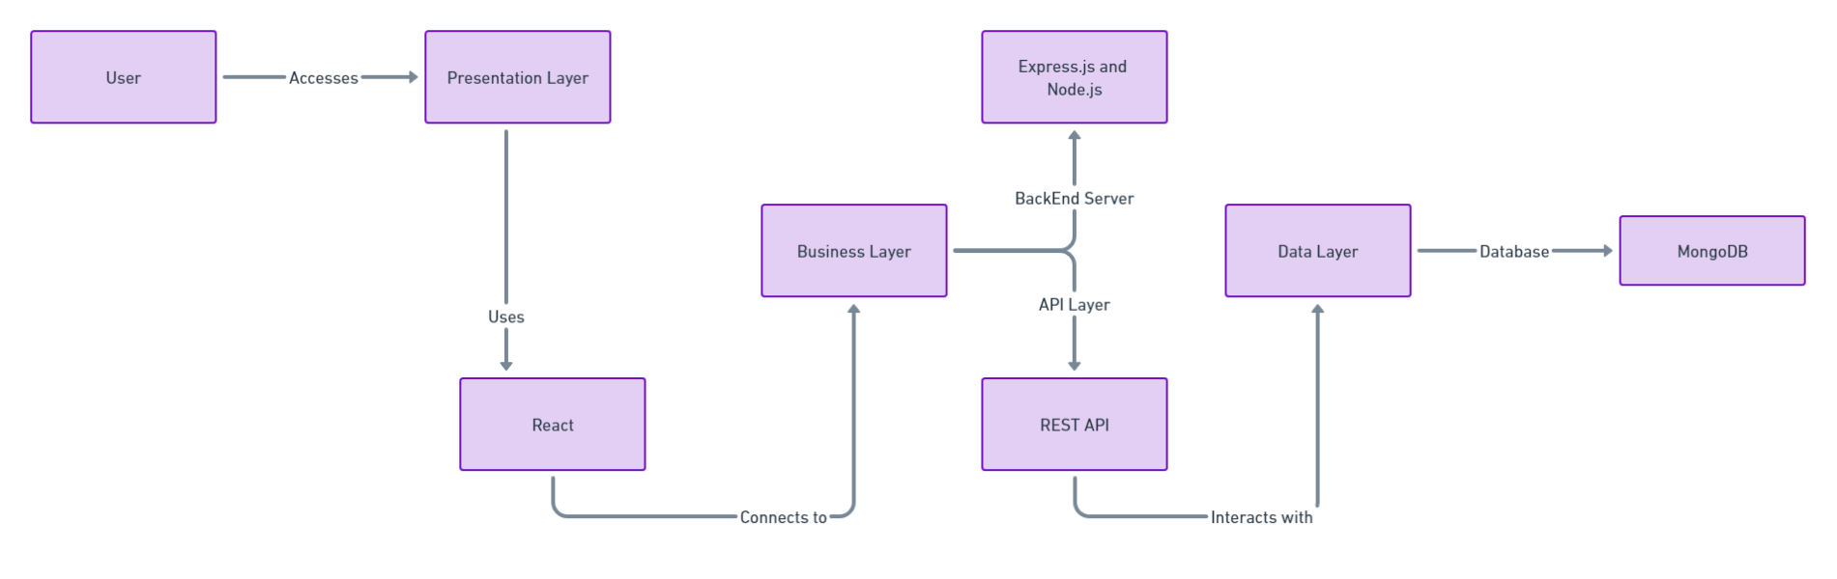
Architectural diagram (three-tier architecture)
FASTIFY

Slide 26
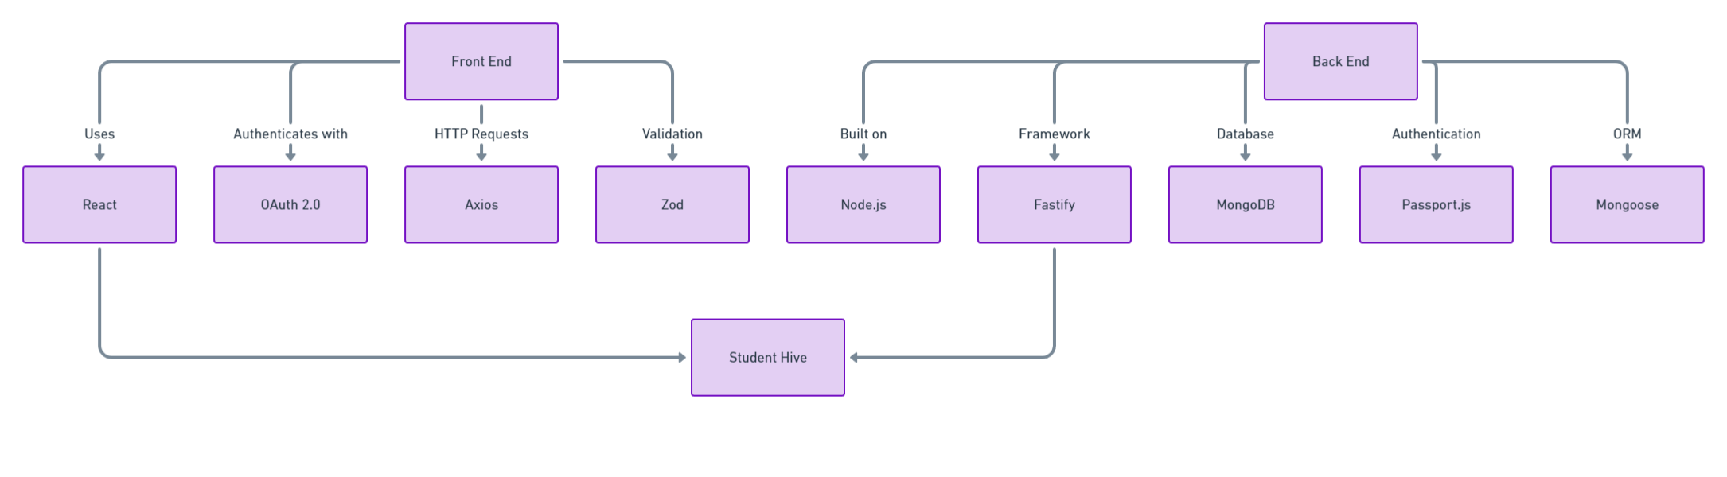
Architectural diagram (EXTENDED)

Slide 27
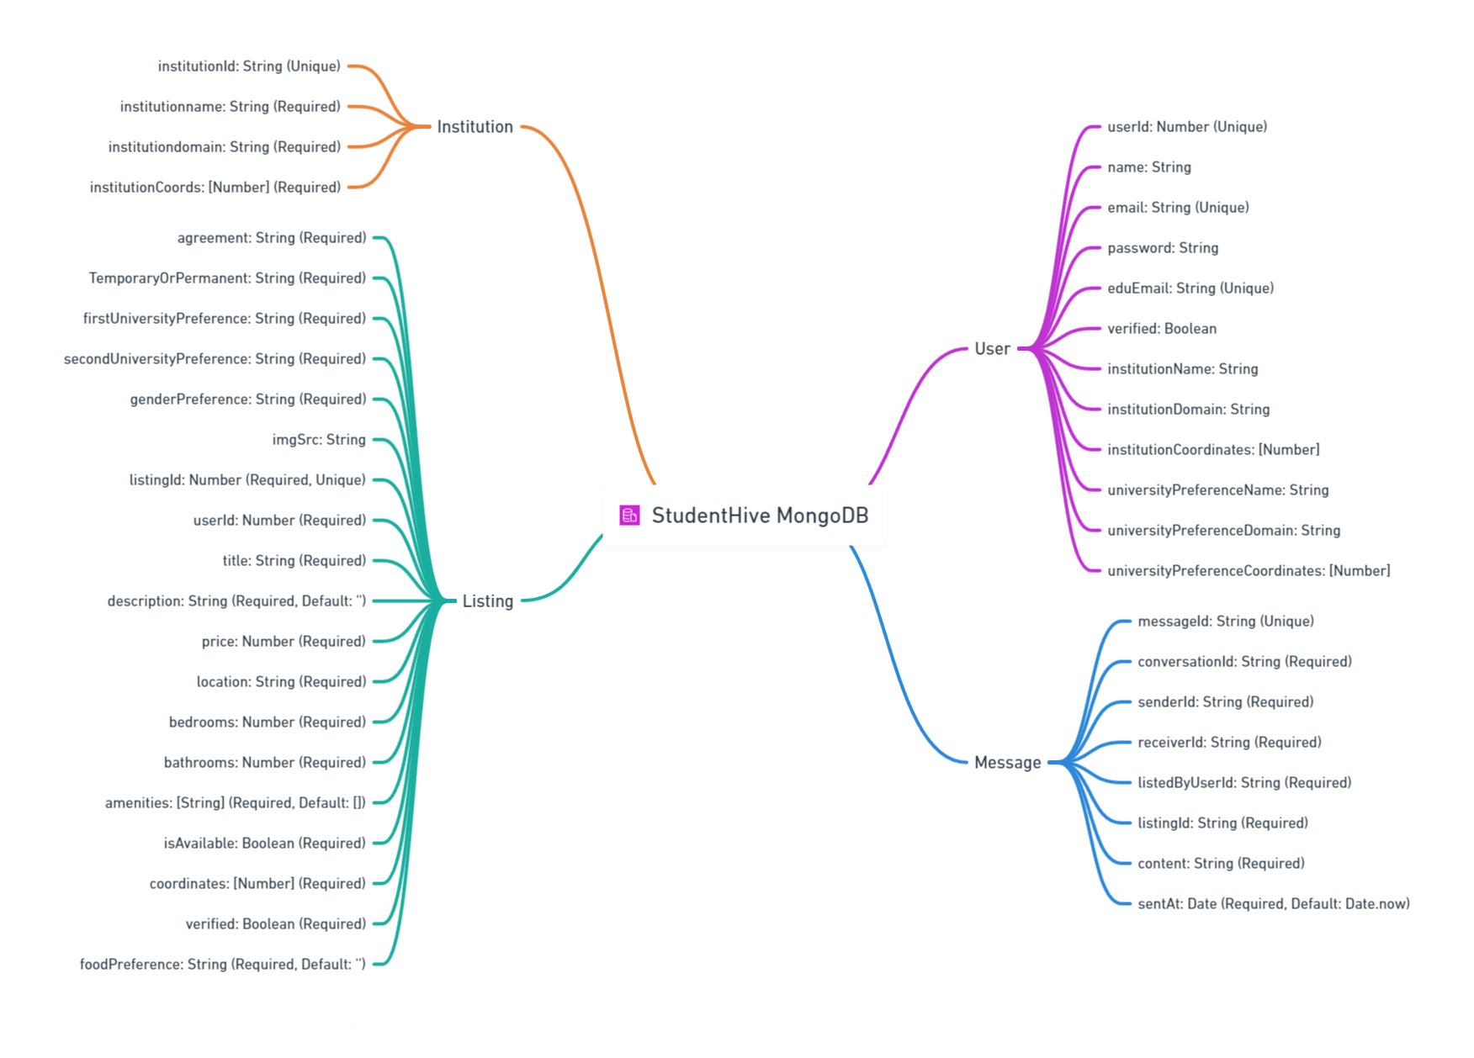
ER diagraM

Slide 28
PRODUCT BACKLOG

Slide 29
USER STORIES

Slide 30
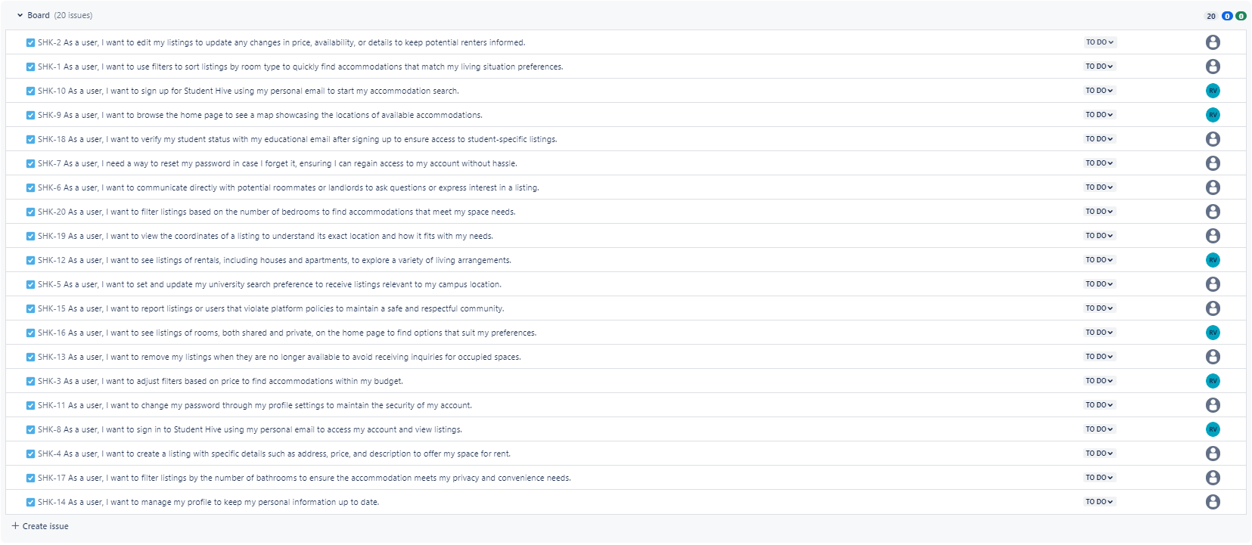
USER STORIES

Slide 31
SPRINT 3 BACKLOG

Slide 32
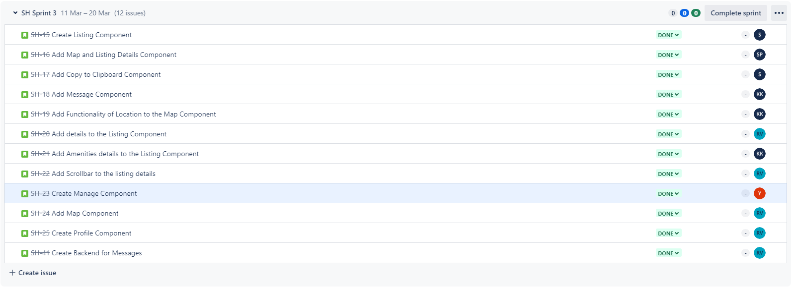
SPRINT 3

Slide 33
ACCEPTANCE CRITERIA

Slide 34
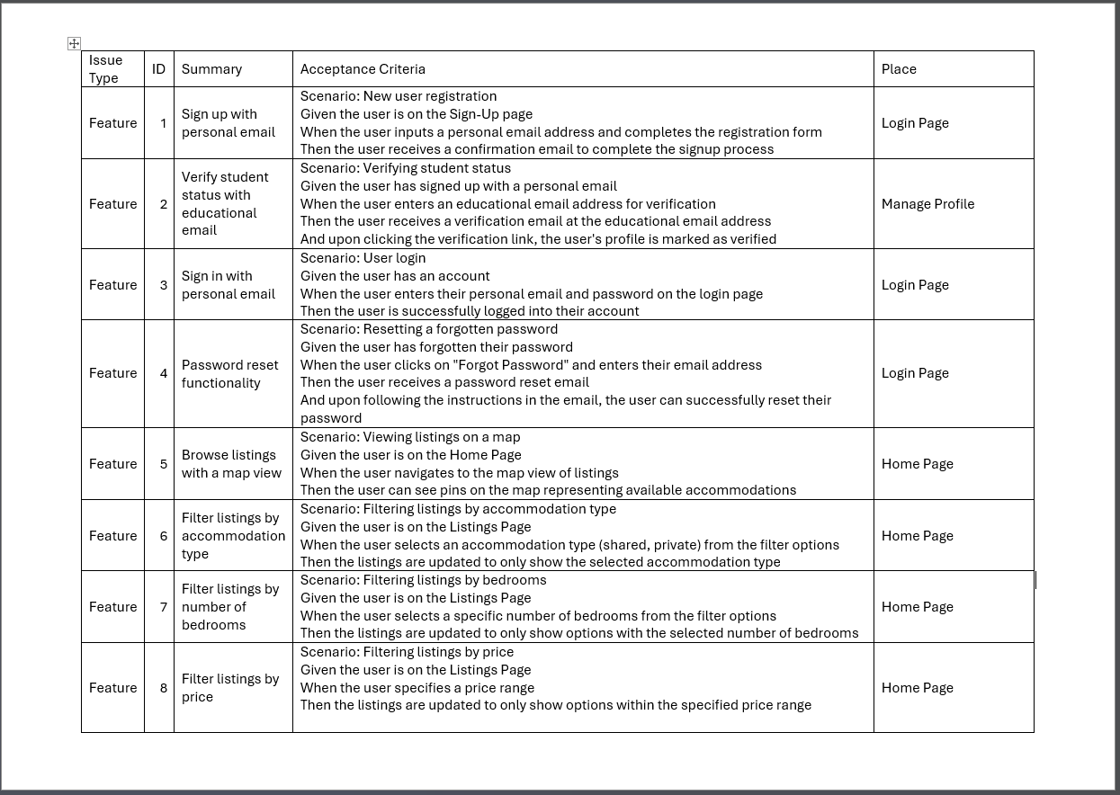
ACCEPTANCE CRITERIA

Slide 35
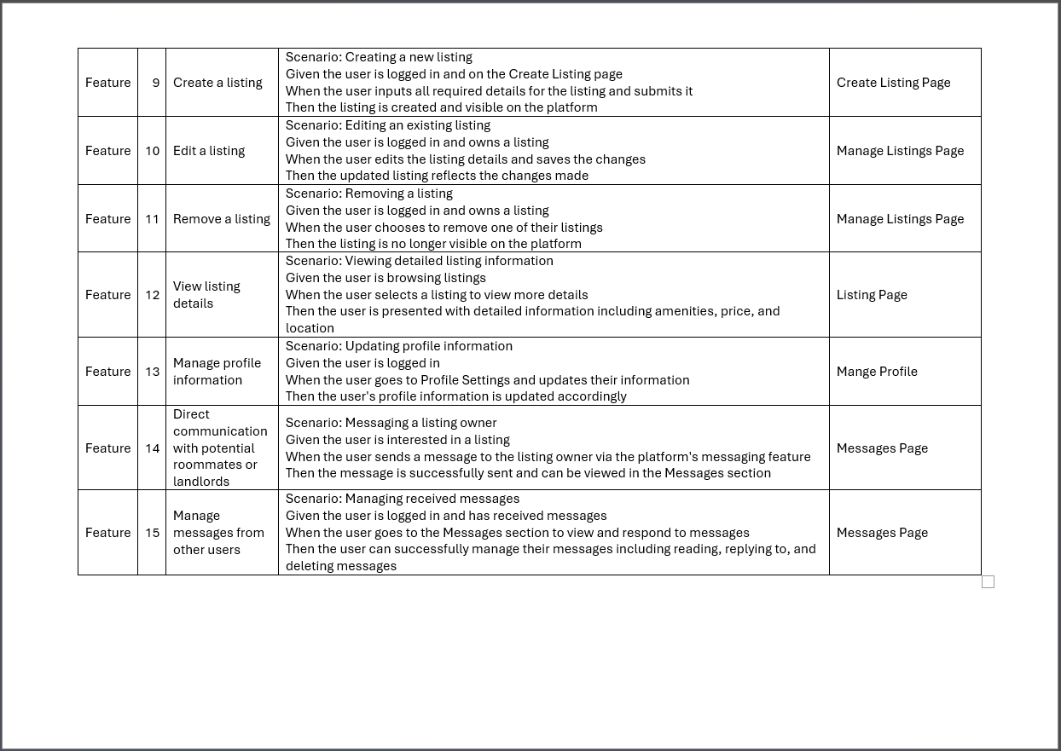
ACCEPTANCE CRITERIA

Slide 36
TEST CASES

Slide 37
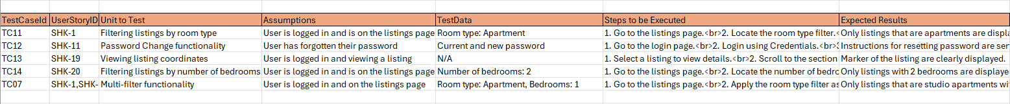
TEST CASES

Slide 38
STORIES COMPLETED

Slide 39
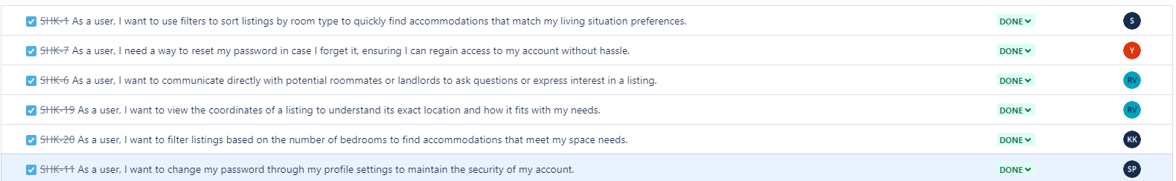
STORIES COMPLETED

Slide 40
STORIES NOT COMPELETED - None

Slide 41
METRICS

Slide 42
TEAM VELOCITY

Slide 43
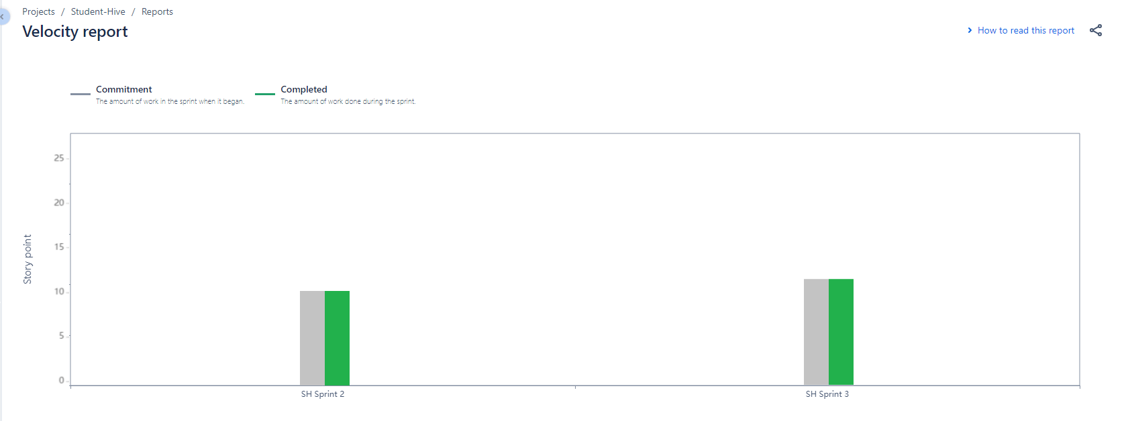
TEAM VELOCITY

Slide 44
SPRINT BURNDOWN CHART

Slide 45
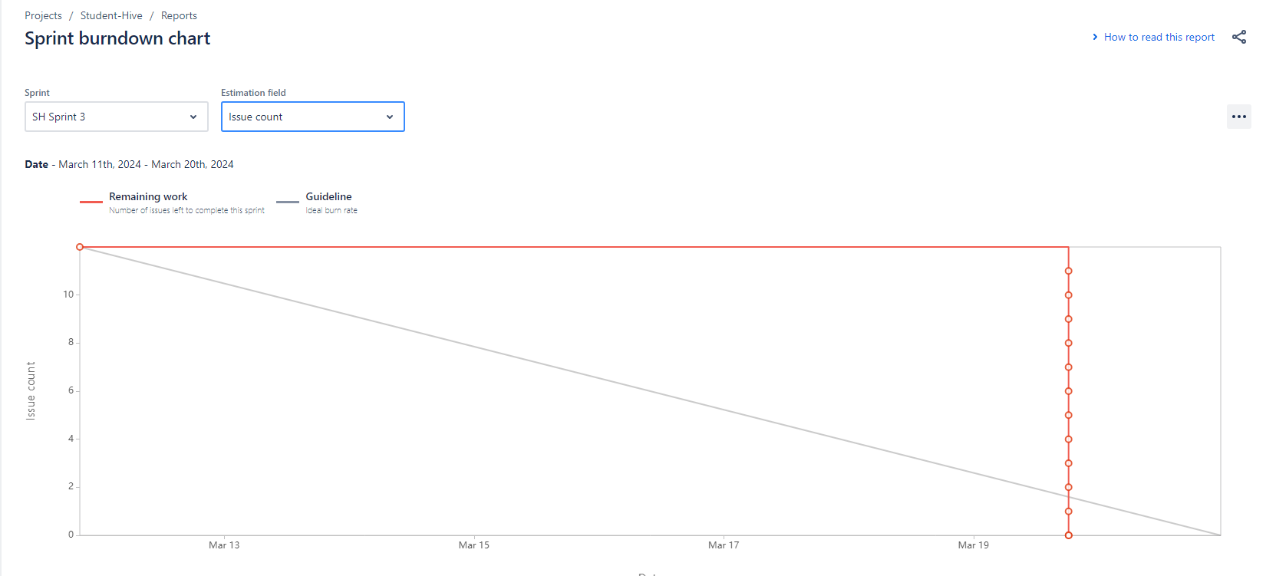
SPRINT BURN DOWN CHART

Slide 46
TEAM HISTORICAL VELOCITY

Slide 47
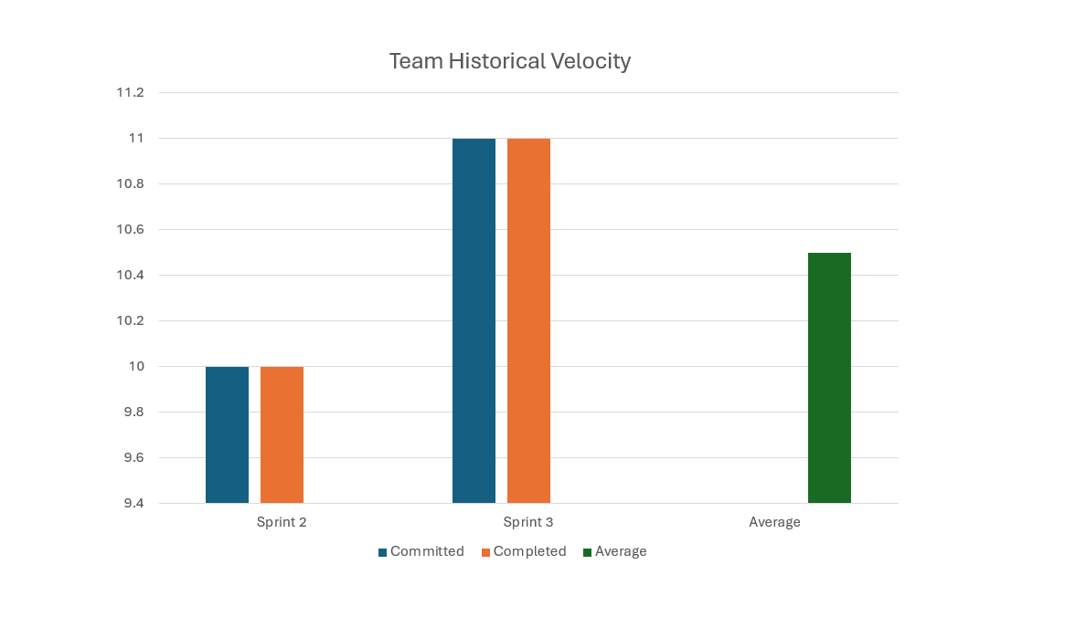
TEAM HISTORICAL VELOCITY

Slide 48
COMPLETED COMMITTED RATIO

Slide 49
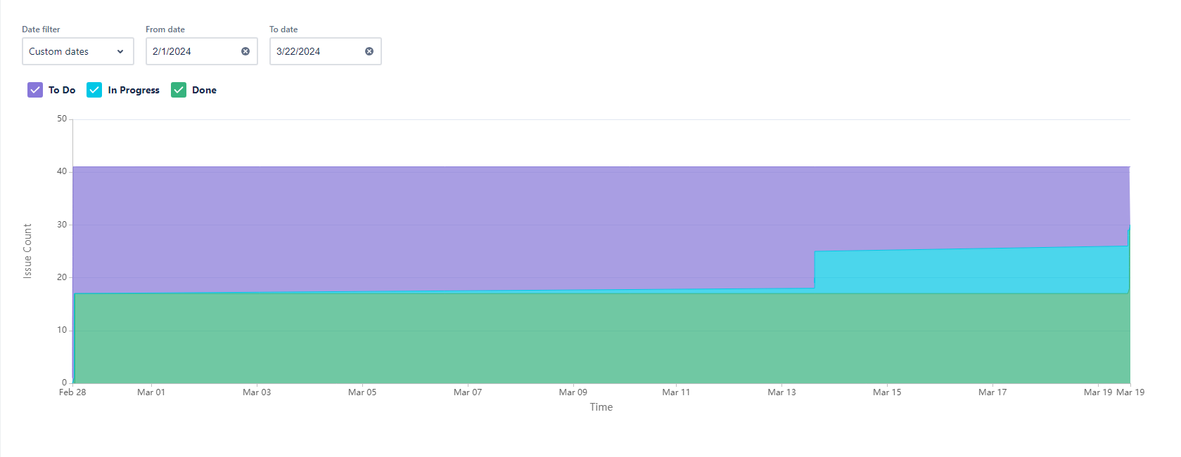
COMPLETED COMMITTED RATIO

Slide 50
RETROSPECTIVE

Slide 51
What went well
Effective Communication: The team's communication was clear and consistent, facilitating smooth collaboration and quick resolution of any issues that arose.
Adaptability: The team showed remarkable adaptability in responding to unexpected challenges, quickly pivoting strategies to stay on course with project objectives.
What needs improvements
Resource Allocation: There were instances where resource allocation did not match task urgency or complexity, leading to delays. A more strategic approach to assigning tasks and resources is needed.
Documentation: While the work progressed well, documentation lagged behind. Improving real-time documentation practices will ensure all team members have access to up-to-date information.
Next steps
Review and Adjust Resource Allocation: Conduct a thorough review of resource allocation processes and implement a more dynamic approach to ensure resources match project needs more accurately.
Implement a Documentation Strategy: Develop and introduce a strategy for ongoing documentation, including designated documentation days or integrating documentation time into task estimates.

Slide 52
PROJECT DEMO

Slide 53
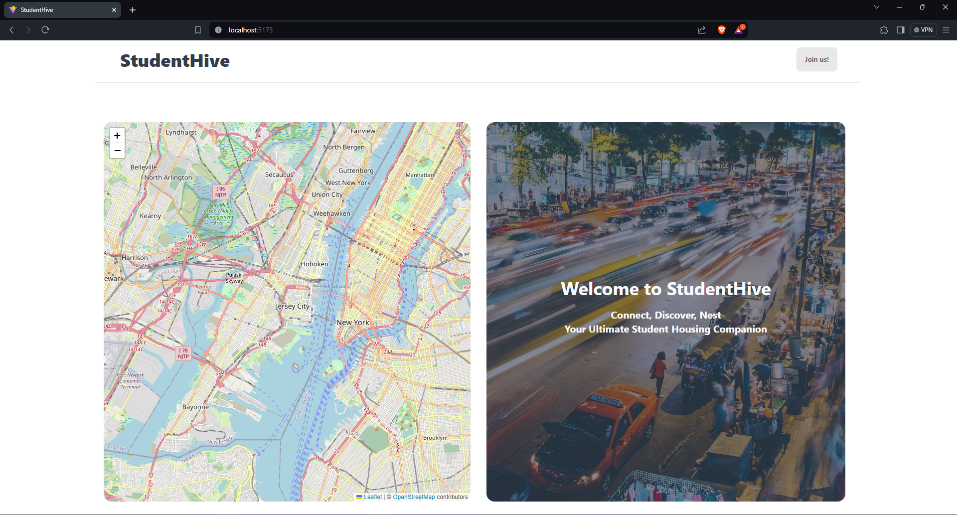
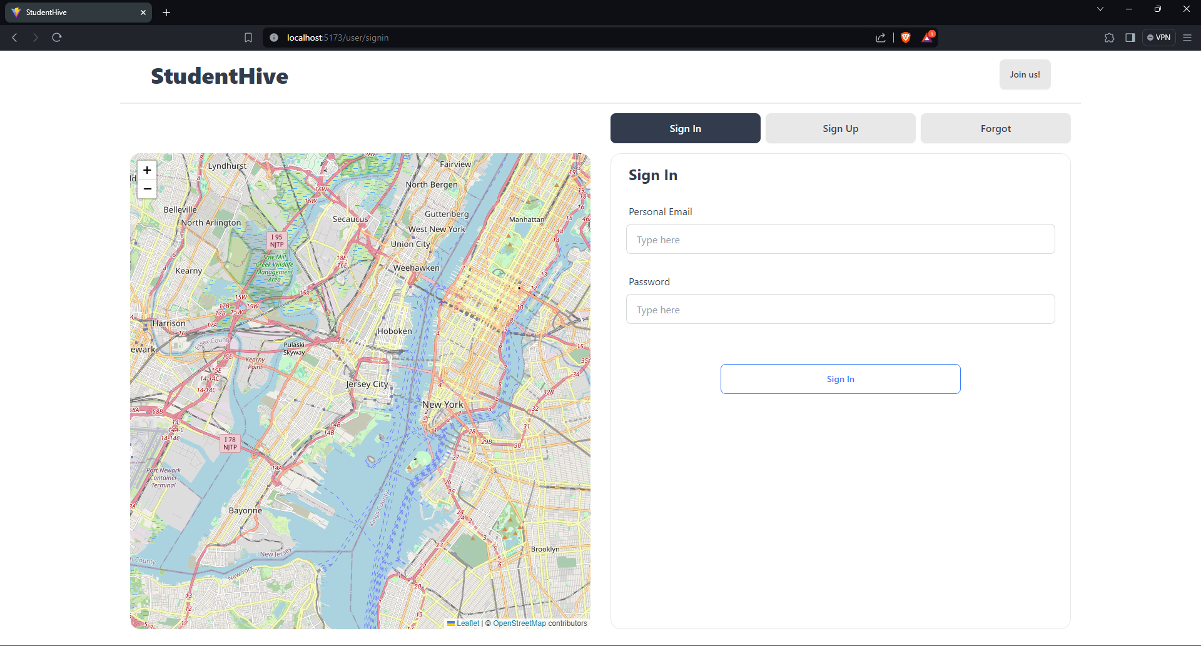
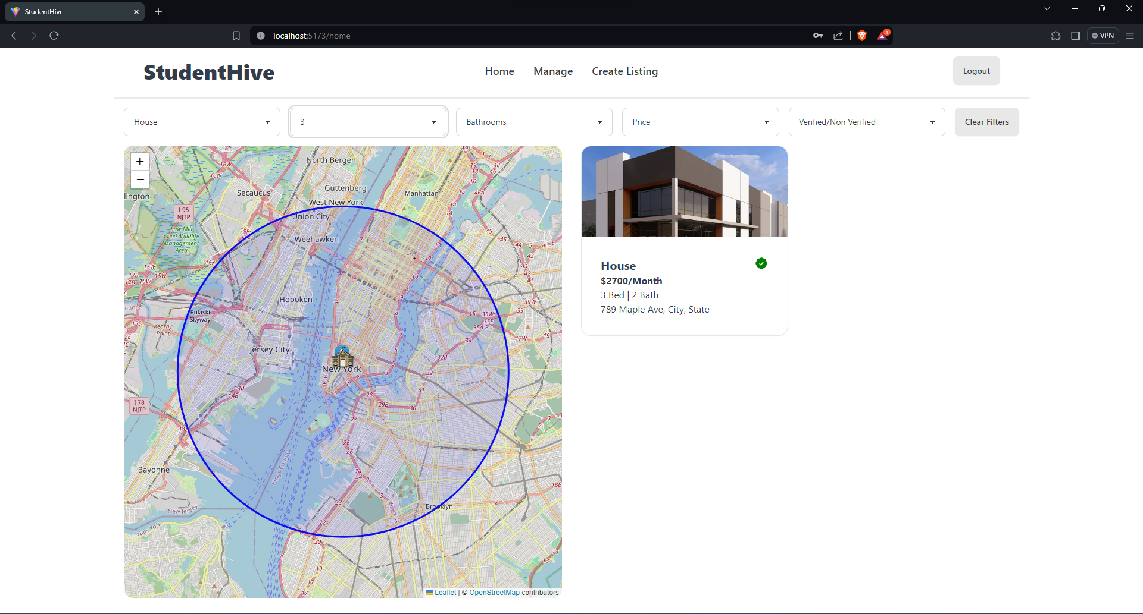
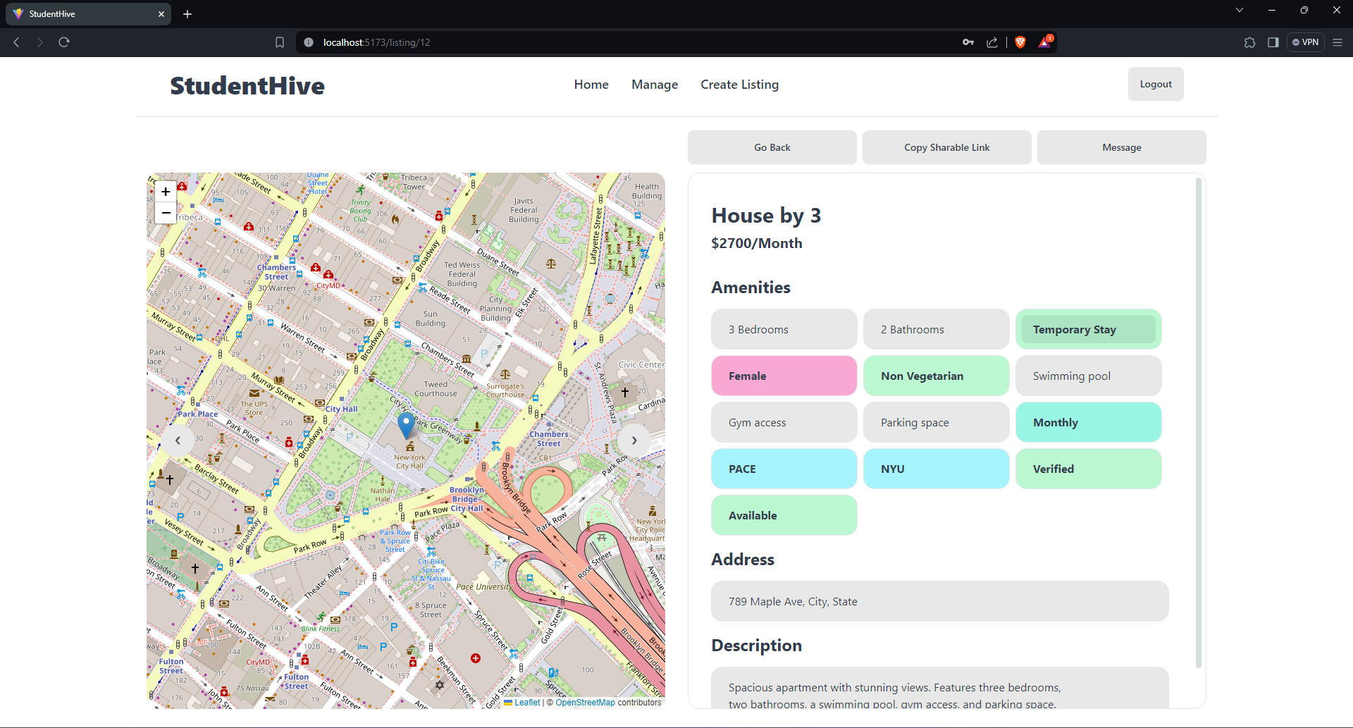

Slide 55
GITHUB LINK

Slide 56
WIKIPAGE LINK
https://github.com/rajkoushikv/studenthive/wiki/Wikipage

Slide 57
THANK YOU

